Slide 1
Letterkenny DotNet Azure User Group
2018
Letterkenny, Ireland
Date: Saturday, 10th Nov Time: 9:00AM – 5:30PM
Organized By:
The Microsoft User Group for Donegal County
http://lk-mug.org
@lkmsug
Letterkenny
.MUG

Slide 2

Welcome To:
Letterkenny, Ireland
It is a free, one-day, hands-on training event led by Microsoft MVPs with support from Microsoft and local community leaders.
Developers worldwide are invited to attend the bootcamp to learn the latest on Office 365 platform including Microsoft Graph, SharePoint Framework, Microsoft Teams, Office Add-ins, Connectors and Actionable Messages and apply what you learn to your future projects.
Letterkenny Microsoft User Group(LK-MUG) & Pramerica brings you this event in Letterkenny.

Slide 3










Letterkenny
.MUG
Letterkenny Dotnet Azure UG
Hosted by
Venue:
Pramerica
Letterkenny Business & Technology Park
Letterkenny, Donegal, Ireland
Date:
Saturday, 10th Nov
Time:
9:00AM – 5:30PM
Register at:
https://lnkd.in/ee8STGe
Event Sponsors

Slide 4

Letterkenny, Ireland
Agenda:
Date: Saturday, 10th Nov Time: 9:00AM – 5:30PM
Time | Session | Speaker
9:00AM – 9:30AM | Registration & Networking Breakfast
9:30AM – 10:00AM | Welcome and Keynote (Introduction to the Office 365 developer landscape) | Richard Fisher (Solutions Architect, Pramerica)
10:00AM – 11:15AM | Deep Dive into Power Apps and Flow Automating internal job application | Ray Hogan (Senior Specialist, Pramerica)
11:15AM -- 11:30AM | Break
11:30AM – 12:30PM | Build your first SharePoint Framework web part Creating a Web part Debugging a Web part Integrate Web part with GitHub data * Participants would setup necessary tool chain | Joon Du Rant/ Nithin Mohan (Senior Specialist, Pramerica) Velin Georgiev
12:30PM – 1:30PM | Lunch Break + Networking
1:30PM – 2:00PM | Introduction to Microsoft Graph | Joon Du Rant (Solutions Architect, Pramerica)
2:00PM - 3:30PM | Build SharePoint Framework Client-Side Web Parts Using the Microsoft Graph JavaScript SDK | Austin Breslin (Specialist Dev, Pramerica)
3:30PM - 3:45PM | Break
3:45PM – 5:00PM | Getting Started – OfficeDevPnP PowerShell and PnP Provisioning Engine | Velin Georgiev (Technical Architect, Pramerica)
5:00PM – 5:45PM | Q&A’s, Closing Note and Swag time | Richard Fisher

Slide 5
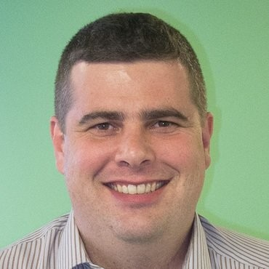
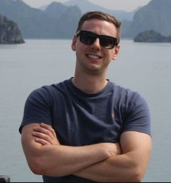

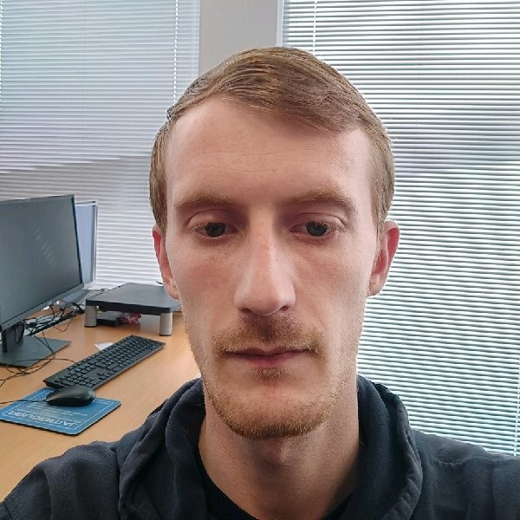
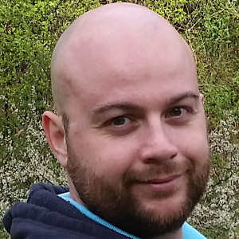
Speakers
Joon Du Rant
Ray Hogan
Richard Fisher
Austin Breslin
Velin Georgiev
Letterkenny, Ireland

Slide 6


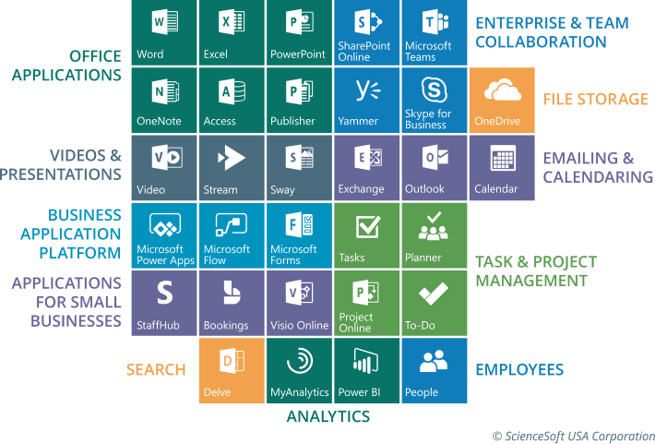
Letterkenny
MUG
#lkmug
Nov 10, 2018
9:00AM – 5:30PM
Pramerica Services,
Letterkenny, Donegal, Ireland
Keynote & Introduction
Introduction to Office 365 Developer Landscape
Richard Fisher
Solutions Architect
Pramerica
@RichJFish
linkedin.com/in/rjfisher-architect
@lkmsug
www.lk-mug.org
#mvpbuzz #Office365 #O365DevBootCamp
Richard Fisher

Slide 7

Letterkenny
MUG
#lkmug
Nov 10, 2018
9:00AM – 5:30PM
Pramerica Services,
Letterkenny, Donegal, Ireland
The Power of PnP PowerShell
Getting started with the PnP Provisioning Engine and PnP PowerShell
Velin Georgiev
Microsoft MVP, Office Dev
UK & Ireland
@VelinGeorgiev
@lkmsug
www.lk-mug.org
https://blog.velingeorgiev.com
#mvpbuzz #Office365 #O365DevBootCamp
Contributor: @pnp/office365-cli

Slide 8


Letterkenny
MUG
#lkmug
Nov 10, 2018
9:00AM – 5:30PM
Pramerica Services,
Letterkenny, Donegal, Ireland
Deep Dive into PowerApps and Flow
Building a HR job application workflow with PowerApps and Flow
Ray Hogan
Senior Specialist
Pramerica Services
@RayHogan
@lkmsug
www.lk-mug.org
https://rhogan.ie
#mvpbuzz #Office365 #O365DevBootCamp
linkedin.com/in/ray-hogan

Slide 9
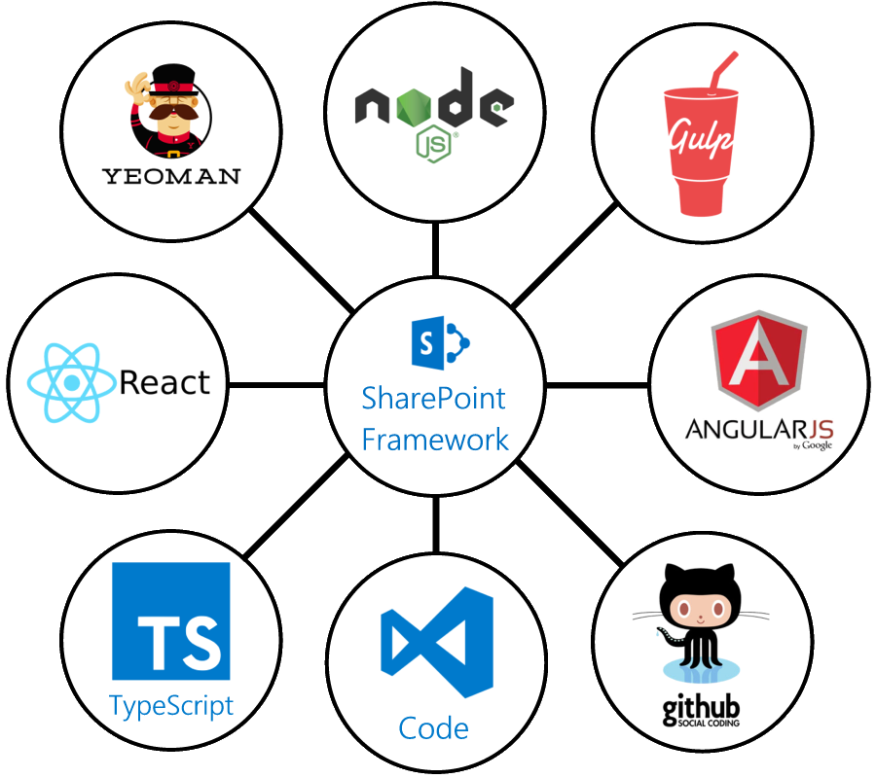
Letterkenny
MUG
#lkmug
Nov 10, 2018
9:00AM – 5:30PM
Pramerica Services,
Letterkenny, Donegal, Ireland
Introduction to
SharePoint Framework
Build your first SharePoint Framework web part
Joon Du Rant
Solutions Architect
Pramerica
@joon_net
linkedin.com/in/joondurandt/
@lkmsug
www.lk-mug.org
#mvpbuzz #Office365 #O365DevBootCamp
Richard Fisher

Slide 10
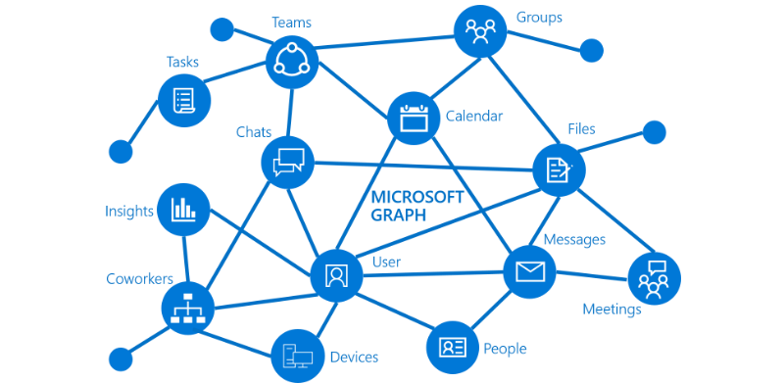
Letterkenny
MUG
#lkmug
Nov 10, 2018
9:00AM – 5:30PM
Pramerica Services,
Letterkenny, Donegal, Ireland
Introduction to Microsoft Graph
Build smarter Productivity apps using Microsoft Graph
Joon Du Rant
Solutions Architect
Pramerica
https://developer.microsoft.com/en-us/graph
@joon_net
linkedin.com/in/joondurandt/
@lkmsug
www.lk-mug.org
#mvpbuzz #Office365 #O365DevBootCamp
Richard Fisher

Slide 11
Letterkenny
MUG
#lkmug
Nov 10, 2018
9:00AM – 5:30PM
Pramerica Services,
Letterkenny, Donegal, Ireland
Integration of Graph JS SDK
Build SharePoint Framework Client-Side Web Parts Using the Microsoft Graph JavaScript SDK
Austin Breslin
Senior Developer
Pramerica
@AustinBreslinDev
linkedin.com/in/austin-breslin-84b4a74b
@lkmsug
www.lk-mug.org
#mvpbuzz #Office365 #O365DevBootCamp
Richard Fisher

Slide 12

Letterkenny, Ireland
Sponsors:
Date: Saturday, 10th Nov Time: 9:00AM – 5:30PM
Venue & Refreshments
RAFFLE for one, 1 year license
RAFFLE for one, 1 year license
Event, Swags, T-Shirts
Letterkenny
.MUG

Slide 13
Letterkenny DotNet Azure User Group
2018
Letterkenny, Ireland
Organizers:
The Microsoft User Group for Donegal County
http://lk-mug.org
@lkmsug
Letterkenny
.MUG

Slide 14

Call to action
(Recommendation to Bootcamp organizers and speakers: This slide can be used at the end of the Bootcamp to have attendees to fill online feedback form and recommendation for their ongoing learning and app development on Office 365 platform. Please keep the first three bullet points, you can update the last bullet point to be the user group or community that you are leading that you’d like attendees to join and learn more. Please keep the first feedback bullet point at the top and feel free to re-arrange the rest of bullet point orders. Thanks.
Register for Our Bootcamp: https://lnkd.in/ee8STGe
Join Office 365 developer program https://dev.office.com/devprogram to leverage all resources for Office 365 development learning
Attend the event, learn to Build applications on Office 365 platform
Attend MVP led local community events to continue learning on Office 365 development
https://meetup.com/lk-mug

Slide 15

Enjoy the Bootcamp
Learn something new
from industry experts
Earn free licenses
T-Shirts
Many more..
Water bottles

